Slide 1
A Gentle Introduction
to Machine Learning
Sneha Mondal
IBM Research AI
February 2019

Slide 2
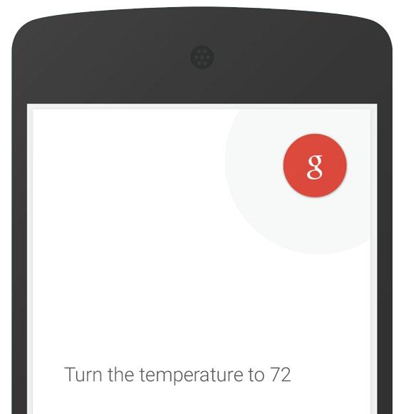
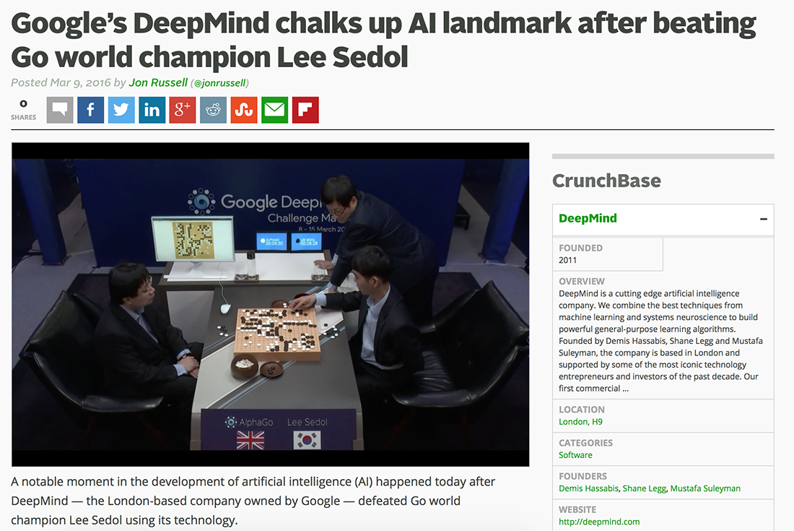
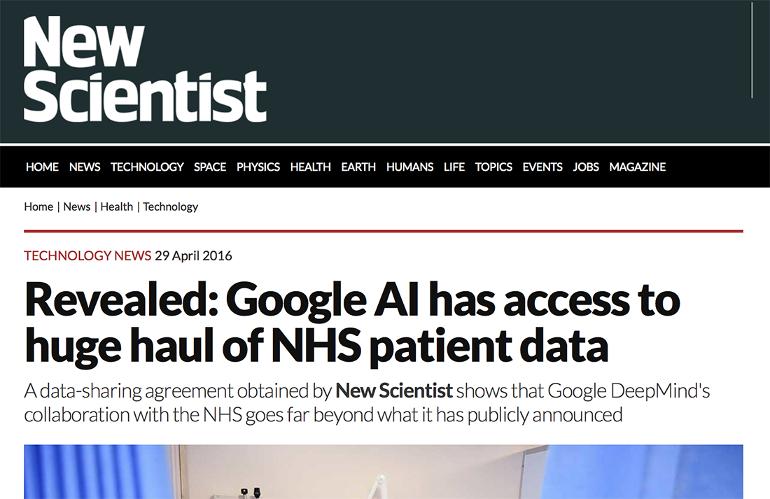
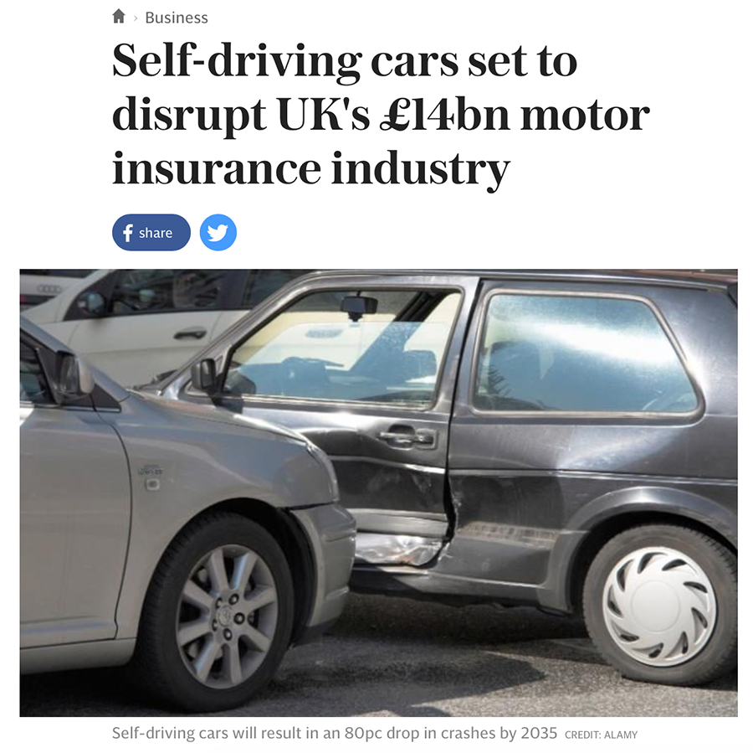
Why ML?

Slide 3
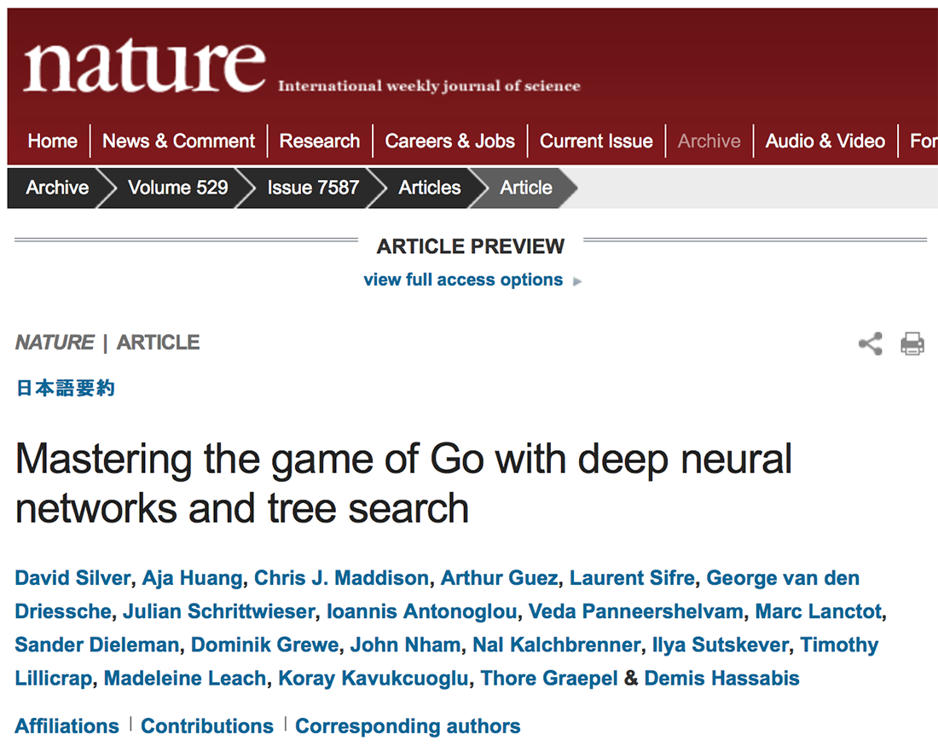
Google’s GO

Slide 4
What makes a problem easy?
Adding two numbers is easy!
int add (int a, int b) {
sum = a + b
return sum
}

Slide 5
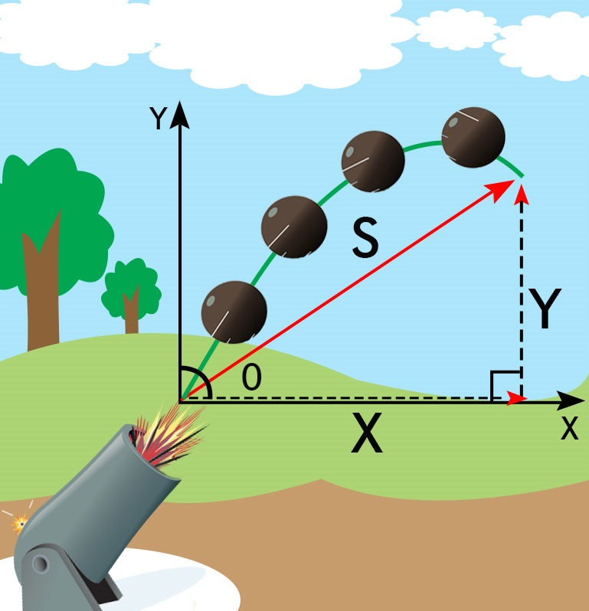
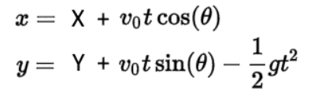
What makes a problem easy?
As is predicting trajectory of a projectile!

Slide 6
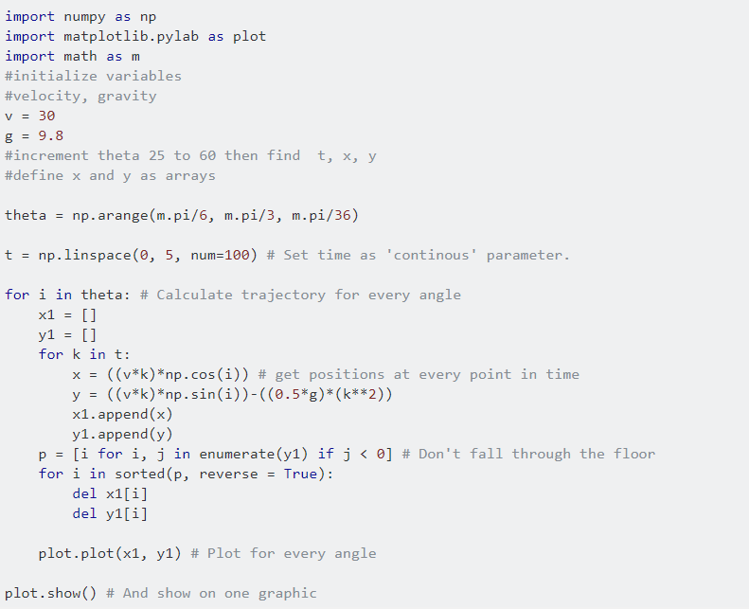
What makes a problem easy?
As is predicting trajectory of a projectile!

Slide 7
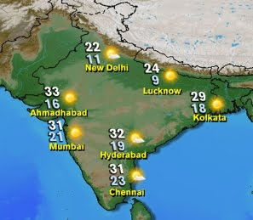
Is predicting rain “easy”?
WEATHER FORECASTING

Slide 8
Is predicting rain “easy”?
Temperature
Humidity
Pressure
Wind speed
Atmospheric stability
TOO MANY FACTORS!

Slide 9

What is Learning?

Slide 10
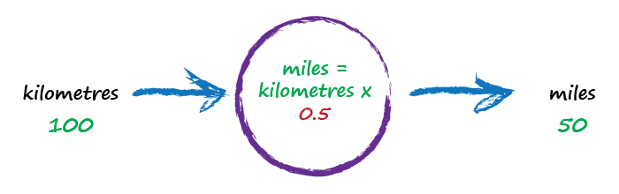
Kilometres to Miles
random starting multiplier

Slide 11
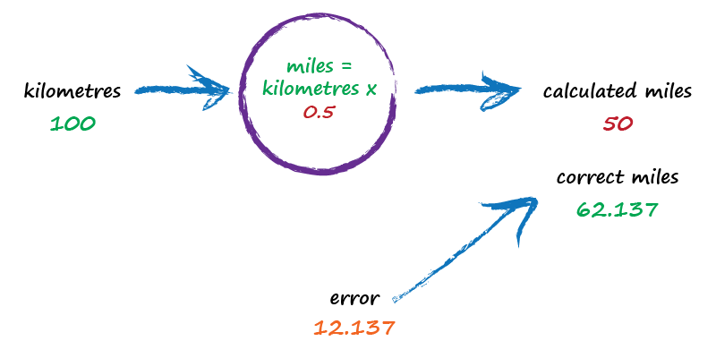
Kilometres to Miles
not great

Slide 12
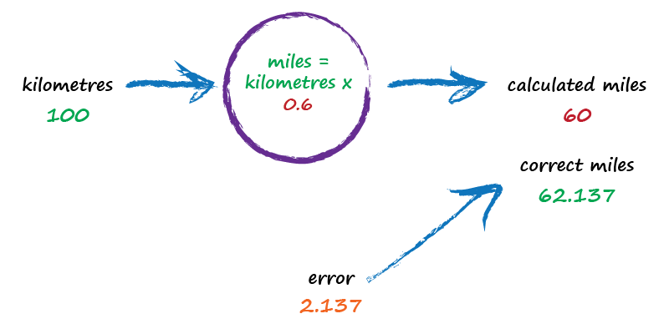
Kilometres to Miles
better

Slide 13
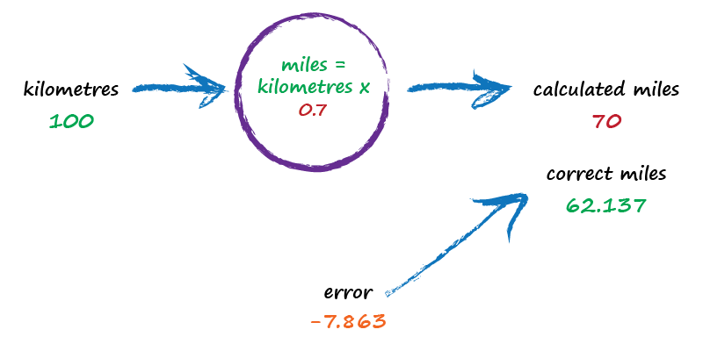
Kilometres to Miles
worse !

Slide 14

Kilometres to Miles
best yet !

Slide 15
Kilometres to Miles
we just learnt a MODEL

Slide 16
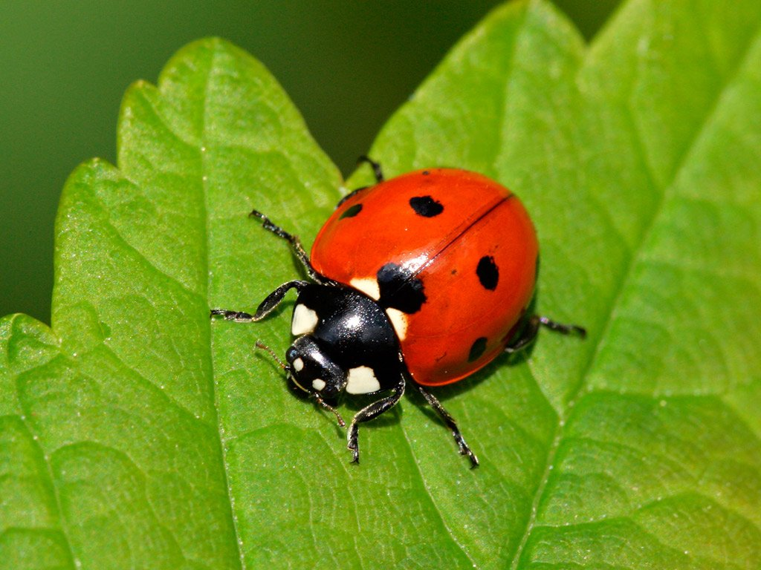
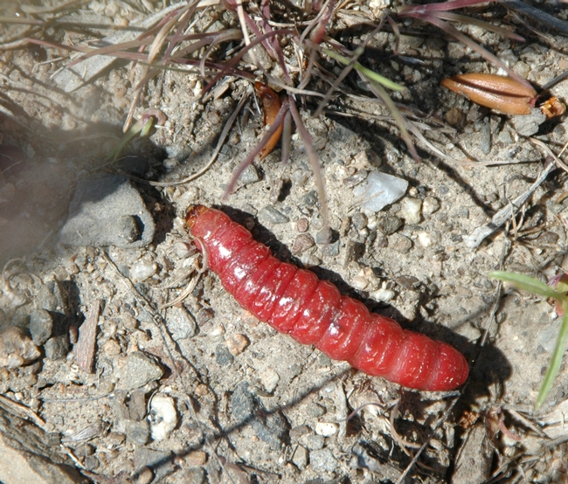
Ladybirds vs. Caterpillars

Slide 17
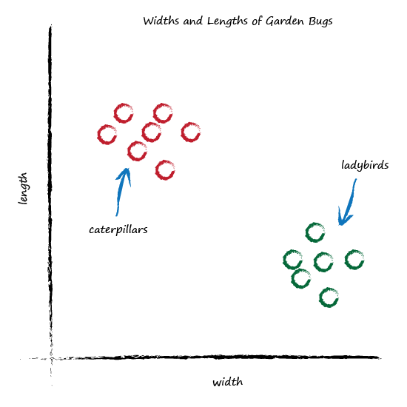
Garden Bugs - Features

Slide 18
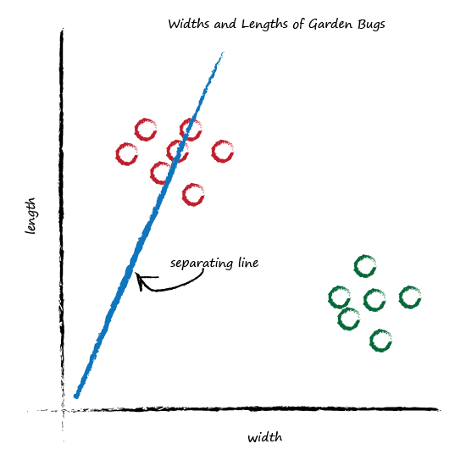
Classifying Bugs

Slide 19
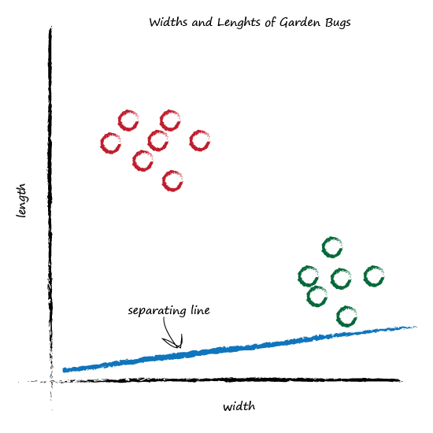
Classifying Bugs

Slide 20
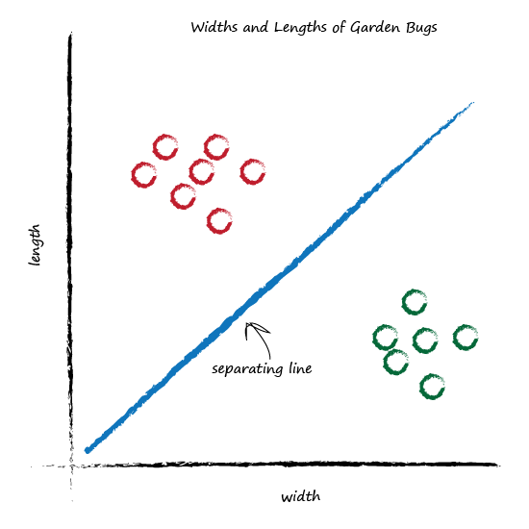
Classifying Bugs

Slide 21
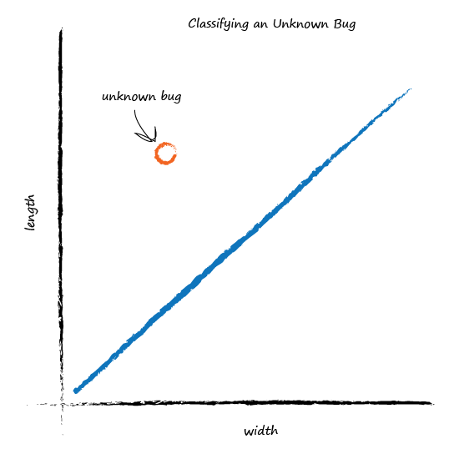
Classifying Bugs - Test on a new Bug!

Slide 22
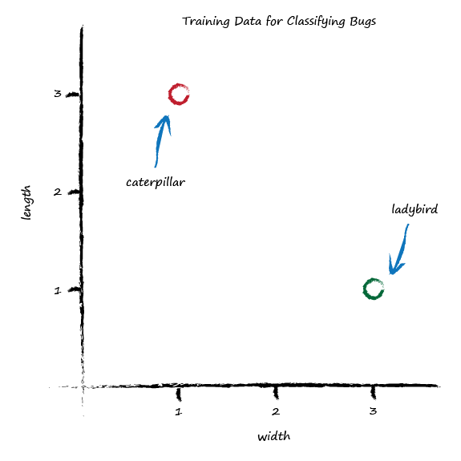
What are we learning?

Slide 23
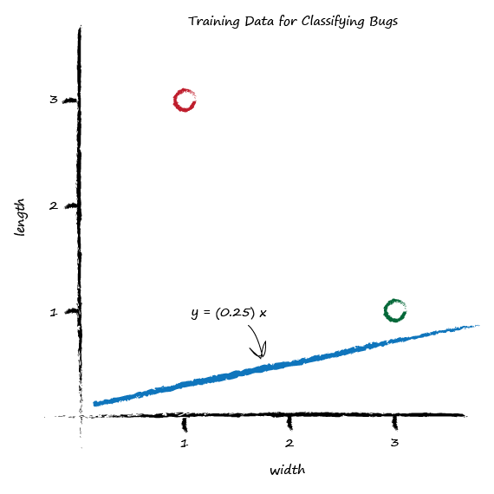
Learning from Data
not a good separator

Slide 24
Learning from Data
shift the line up
just above the training data point

Slide 25
Learning from Data
also a MODEL!

Slide 26
Machine Learning Paradigm
MACHINE LEARNING PARADIGM
Initialise
Train
Computer “error” wrt True Label
set initial parameters
do the learning
(duh!)
query for answers

Slide 27


Key Points
Use features to represent data!
Don’t know how something works exactly? Try a model with adjustable parameters.
Use error to refine parameters
Predict on unseen data.
Pat yourself on the back!

Slide 28
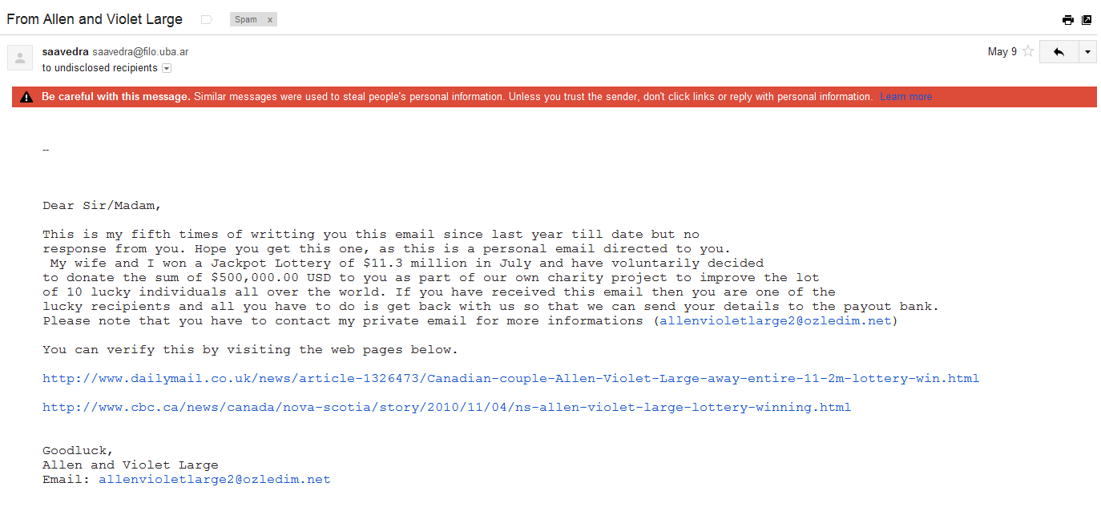
Types of Learning - Classification
SPAM FILTER

Slide 29
Types of Learning - Classification
CLASSIFICATION

Slide 30
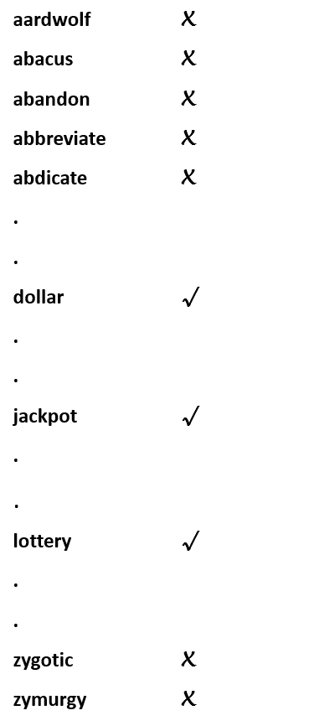
SPAM FILTER – FEATURES?
Dictionary
0 0 0 0 . . . 1 . . 1 . . 1 . . 0
BINARY FEATURES!

Slide 31

Types of Learning - Regression
HOUSE PRICE PREDICTION

Slide 32
Classification vs Regression
What is the output?
Discrete Value
Numerical Value
Classification
Regression
Spam or Not-Spam
Which animal?
Price of house/stock/amazon product
Marks in final exam

Slide 33
House price prediction
Carpet area
Number of Bedrooms
Close to Airport?
Close to Main Road?
Has a Swimming Pool?

Slide 34
Representing a House
{Area, #Bedrooms, Swimming pool, Distance from airport }
1500 3 1 25
( x_1 x_2 x_3 x_4 ) = X
feature vector

Slide 35

HOUSE PRICE PREDICTION
{Area, #Bedrooms, Swimming pool, Distance from airport }
= ( 1500 , 3, 1, 25 ) 250000
= ( 1000 , 2, 0, 200 ) 120000
= ( 2000 , 5, 0, 135 ) 188000
?
MODEL
= (1800 , 3 , 1 , 75)

Slide 36
regression demo!

Slide 37
QUESTIONS?

